Slide 1
INTRODUCTION TO VECTORISATION AND SEMANTIC SEARCH Transforming Data into Meaningful Insights
Presented by John Staveley MVP

Slide 2

Welcome
Hello, I’m John Staveley, Community lead at LeedsSharp
25 years as software engineer

Slide 3

Why it matters
Search engine icon → “Better search results”
Shopping cart → “Smarter recommendations”
AI brain → “Semantic understanding”

Slide 4
LEXICAL VS Similarity search
Text = “The Quick brown fox jumped over the lazy dog”
Lexical Search: Text Contains ‘Dog’
Semantic Search: Text Contains ‘Animal’

Slide 5
VECTORISATION BASICS
What is a vector?
“Text” → embedding vector (small table of numbers)
“Image” → feature vector
“Audio” → waveform → vector
Arrows showing transformation into a high-dimensional space.

Slide 6
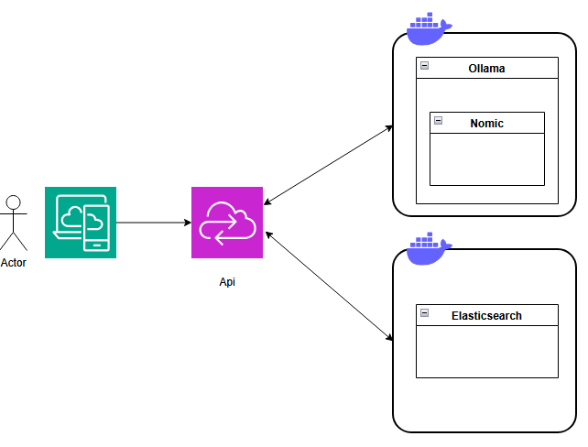
ARCHitecture

Slide 7
SIMILARITY METRICS
Side-by-side mini diagrams:
Cosine similarity → two arrows with small angle.
Euclidean distance → two points with straight line between them.
Dot product → overlapping vectors.
Color-code each metric.

Slide 8
Similarity Search Process
Query → Vectorisation → Index → Search → Results.
Use icons for each step (document, matrix, database, magnifying glass, list).

Slide 9
INDEXING methods
3-column layout:
Brute Force → slow icon (turtle)
ANN → fast icon (rabbit)
HNSW/IVF/PQ → small network diagrams
Include speed vs accuracy bar chart.

Slide 10
Real-World Applications
Grid of 4 images:
E-commerce product grid.
Image search results.
Medical scan comparison.
Face recognition overlay.

Slide 11
CHALLENGES
Warning icons with short text:
Storage icon → “High-dimensional cost”
Scales icon → “Bias in embeddings”
Refresh icon → “Dynamic datasets”

Slide 12
Future Trends
Futuristic gradient background.
cons for:
Multimodal AI (text+image+audio combined)
Mobile device with lock (on-device search)
AI brain with gears (self-learning indexes).

Slide 13
Summary
Data -> Vectors
Vectors -> Similarity Search
AI -> Smarter Results
Slides and code: https://github.com/johnstaveley/Vectorisation
Any questions?

Slide 14

Q & A
…

